Slide 1
Proposal for a weighted gradient vector field enabling optimal obstacle avoidance
Presented by: Garrett Clem
Advisor: Jay Wilhelm
Committee: Dr. Bob Williams, Dr. David Casbeer, Dr. Maarten Uijt de Haag

Slide 2
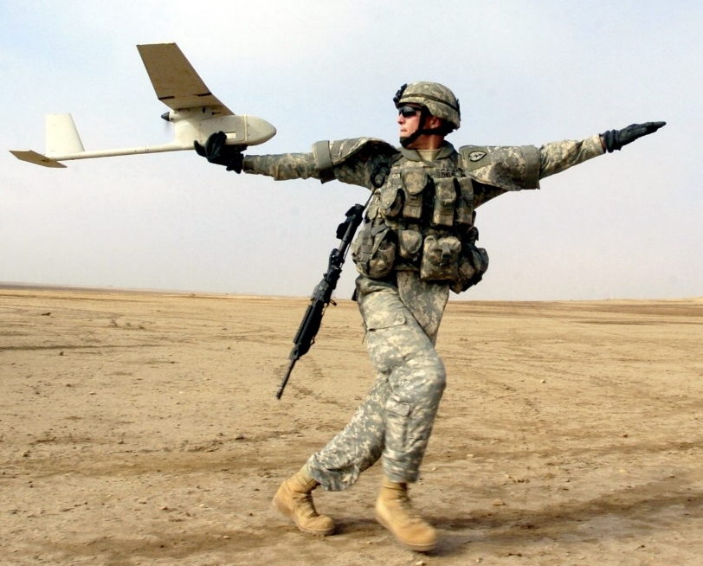
Introduction
Fixed Wing Unmanned Aerial Vehicles (UAVs)
Remotely piloted
On-board flight controller
Maintain stability
Carry out mission objectives
Waypoint navigation
Typically pre-planned at ground station
May consider known obstacles
Dynamic obstacles may require waypoint re-planning
Path following
Connects waypoints with flyable paths
Least error and control effort achieved with vector field methods

Slide 3
Problem Statement and Objectives
Problem Statement: Determine vector field weighting functions that enable optimal obstacle avoidance for fixed wing UAVs
Objectives
Phase 1: Identify specific set of conditions that yields guidance singularity when summing attractive and repulsive GVFs
Phase 2: Determine GVF weighting functions that improve obstacle avoidance
Phase 3: Demonstrate GVF obstacle avoidance with ground robot experiments

Slide 4
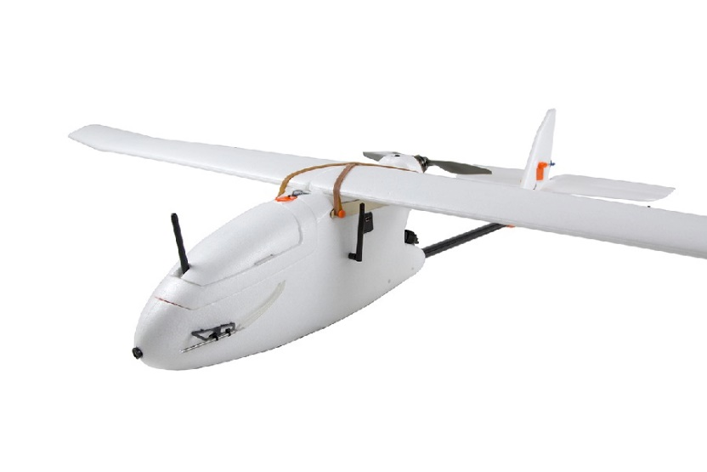
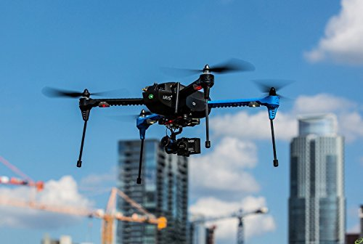
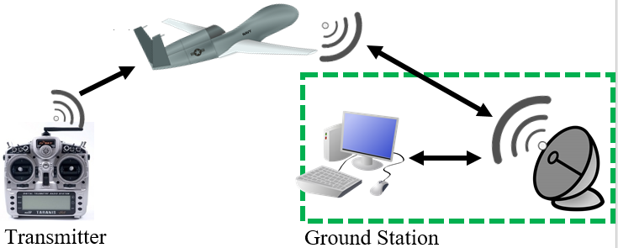
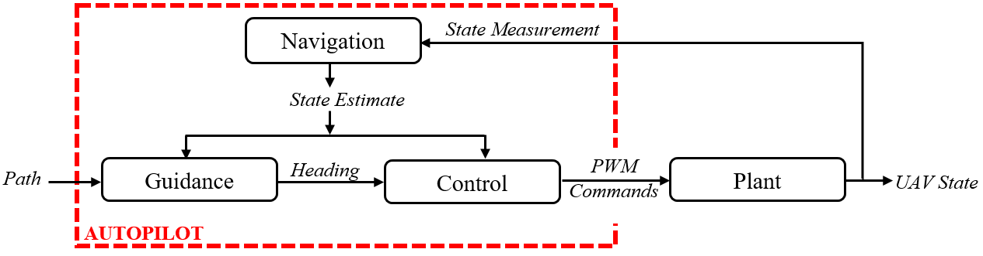
Literature Review
Unmanned Aerial System (UAS)
Aircraft
Fixed wing
Rotorcraft
Transmitter
Ground Station
Autopilot
Navigation
Guidance
Control
Notes:
Unmanned Aerial systems
Fixed wing
Rotorcraft
Autopilot
Navigation, Guidance, and Control
Missions planned at ground station

Slide 5
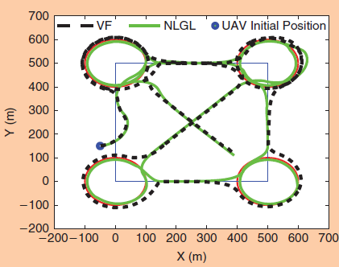
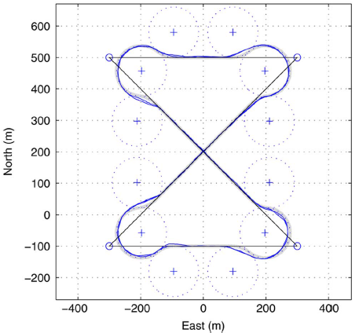
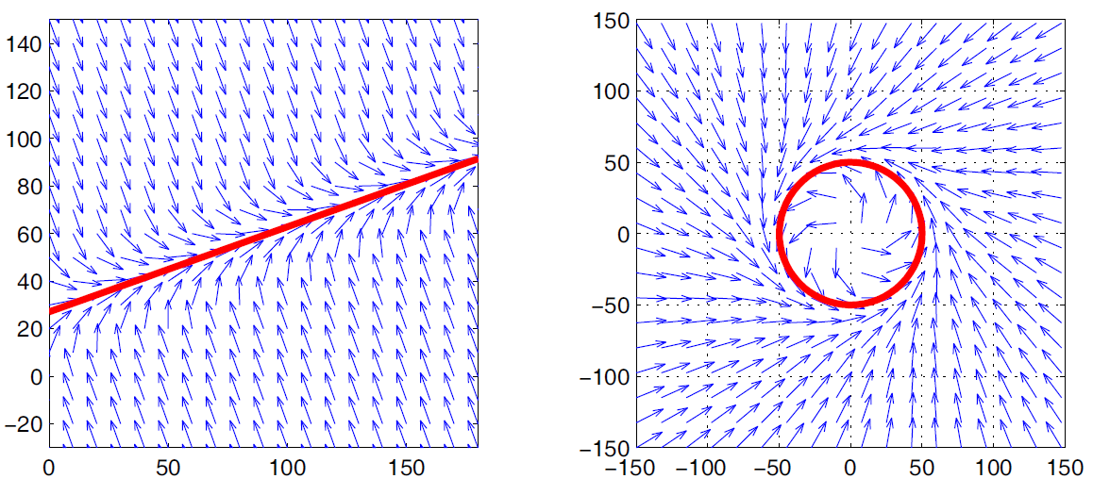
Literature Review
Guidance Methods
[Sujit, 2014]
Guidance provides heading reference commands
Waypoints, path following
Accurate and robust to disturbances
Vector field provided best performance
[Nelson et al., 2005]
Lyapunov vector field primitives
Asymptotically approach curve
Stitch paths together for complex behavior
UAV guidance along path via vector field [Sujit, 2014]
Switching primitives guidance for UAV [Nelson et al, 2005]
Lyapunov vector field path primitives [Nelson et al, 2005]
Notes:
Guidance
Provides reference commands to control system

Slide 6
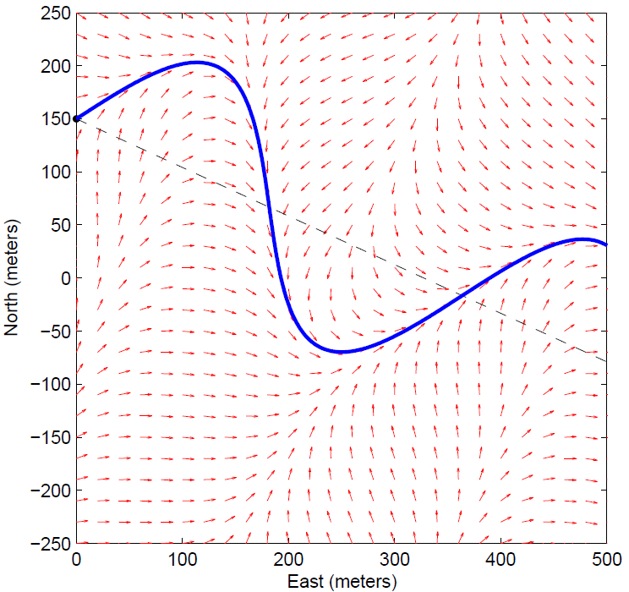
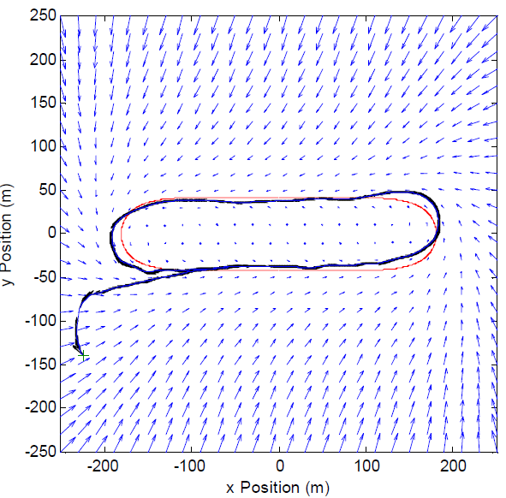
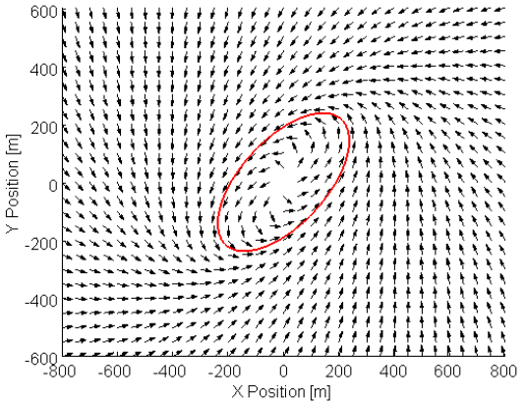
Literature Review
[Griffiths, 2006]
Expanded Nelson ‘s method for arbitrary paths
[Frew, 2007a]
Modify stable field
Non-linear coordinate transformation
[Frew, 2007b]
Modify field shape via position estimate covariance matrix
Standoff tracking uncertain targets
Lyapunov vector field guidance along curved path [Griffiths, 2006]
Non-linear coordinate transformation of stable circular Lyapunov vector field [Frew 2007]

Slide 7
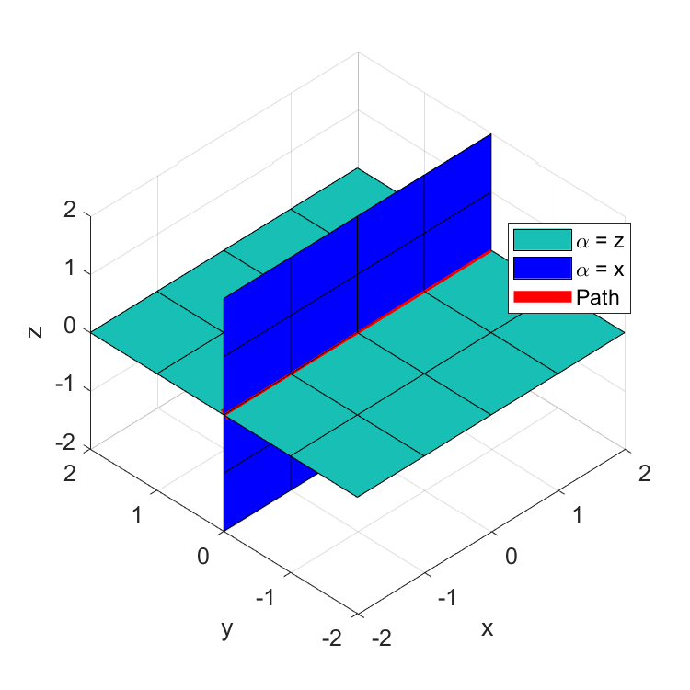
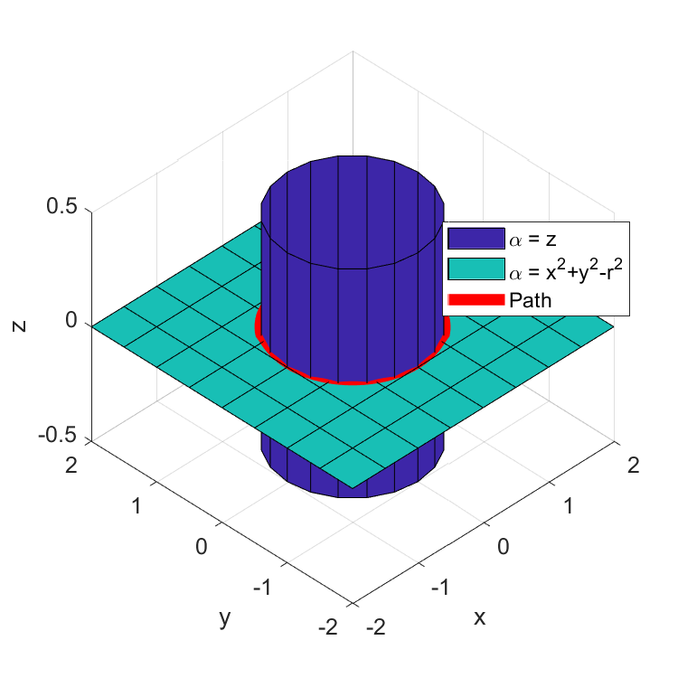


Literature Review
[Goncalves et al, 2009]
N-dimensional vector field
Converge and follows a path
Static
Time varying
Intersection of (n-1) surfaces
Surfaces defined by implicit functions
First order partials differentiable
Bounded second order partials
[Goncalves et al, 2010a]
Experimental validation (2d,3d robotic systems)
[Goncalves et al, 2010b]
Stability proofs of vector field

Slide 8
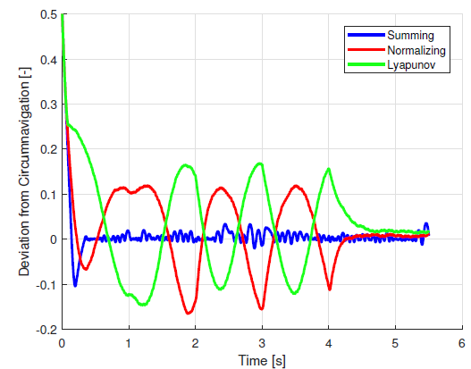
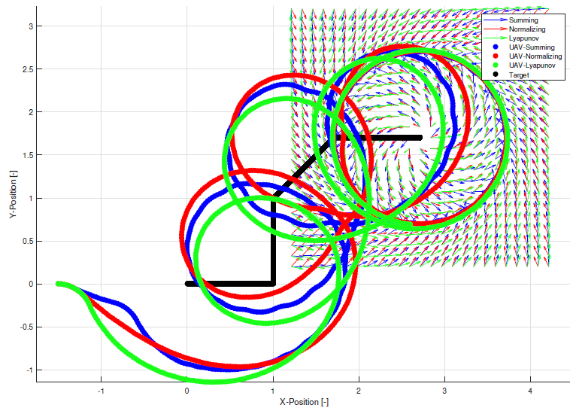
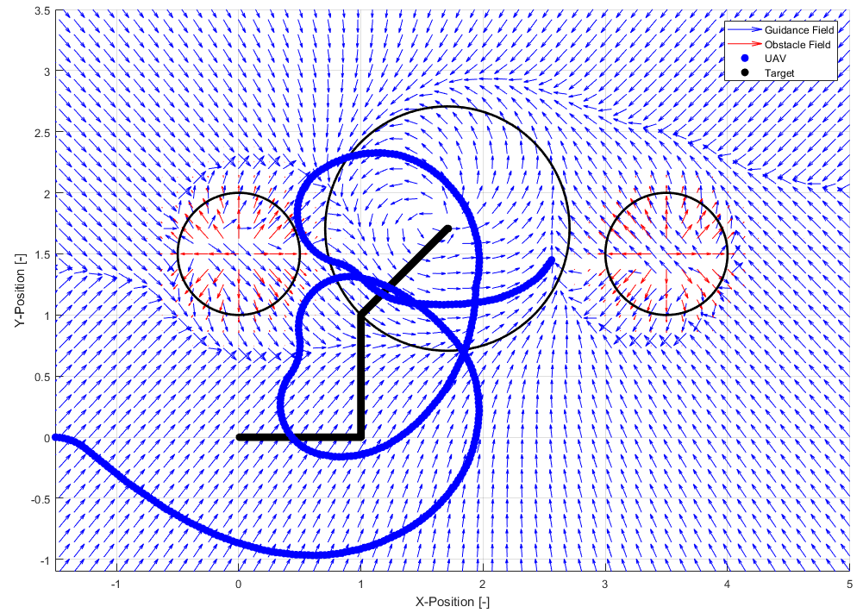
Literature Review
[Wilhelm et al. 2017]
Loiter moving target
Reduced steady-state error in comparison to Lyapunov
Obstacle Avoidance
Goal field tracked target ground vehicle
Repulsive fields representing obstacles
Fields summed resulting in guidance
GVF and Lyapunov tracking a ground target [Wilhelm et al.]
UAV tracking a ground target and avoiding obstacles [Wilhelm et al.]

Slide 9
Phase 1 Overview:
Goal:
Objective:
Tasks:
Demonstrate gradient vector field singularities for circular obstacles
Identify specific set of conditions that yields guidance singularity when summing attractive and repulsive GVFs
Build GVF simulation environment
Evaluate scenarios where singularities are expected
Characterize location of singularities

Slide 10
Phase 2 Overview :
Goal:
Objective:
Tasks:
Determine GVF weighting functions that improve obstacle avoidance
Investigate weighting functions dependent on UAV state
Formulate circulation and convergence weights as functions of UAV state
Determine combination of GVF weights that produces optimal guidance in simulation

Slide 11
Phase 3 Overview :
Goal:
Objective:
Tasks:
Demonstrate GVF obstacle avoidance with ground robot experiments
Validate modified GVF guidance on mobile robot platform simulating fixed wing constraints
Build differential drive robot
Program robotic framework to take guidance commands
Repeat experiments performed in phase 2 on ground robot

Slide 12
Success Criteria
Phase 1:
Phase 2:
Phase 3:
Identified location and conditions that cause vector field singularities
GVF weighted functions provide an improved performance over un-modified GVF guidance
Simulation and experimental results are comparable and modified GVF operates in real time

Slide 13
Thanks
Questions?

